Slide 1

Intro To Raspberry Pi
UTA EE Workshops

Slide 2
The slides and code are here:
www.github.com/EELabMan
Please download the slide to follow along

Slide 3
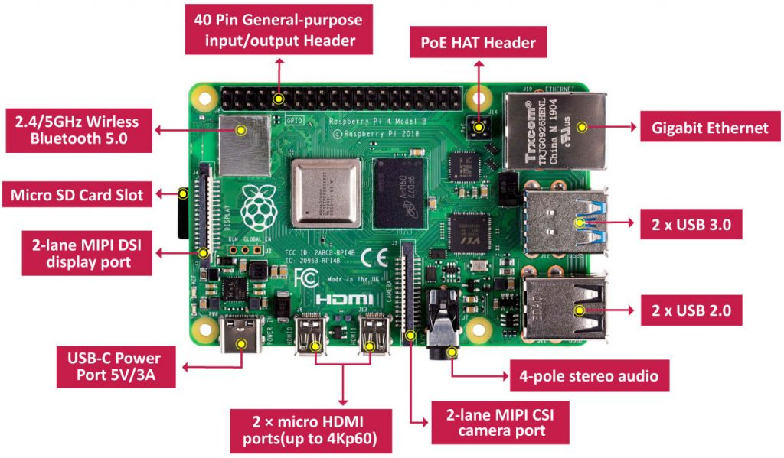
What is a Raspberry Pi?
The Raspberry Pi is a very, very small computer.
You can connect camera, speakers, displays, etc.
It comes with Wifi and Bluetooth built-in.

Slide 4
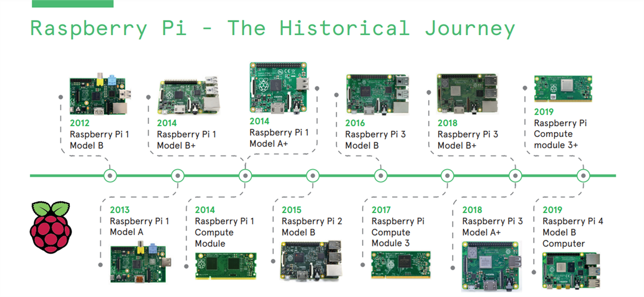
Raspberry Pi Versions
Notes:
This graphic is a little outdated. There are several more devices after 2019 including Compute Module 4 variants, several Pi 4 variants, Pi 0 and Pi 0w, and now they have fully entered the microcontroller market with the Pico (in numerous flavors). The 0 (zero) series is a smaller form factor with reduced memory and less ports, and the Pico series are aduino-esque for use where you may not want a full linux computer like the regular Pi SBCs.

Slide 5
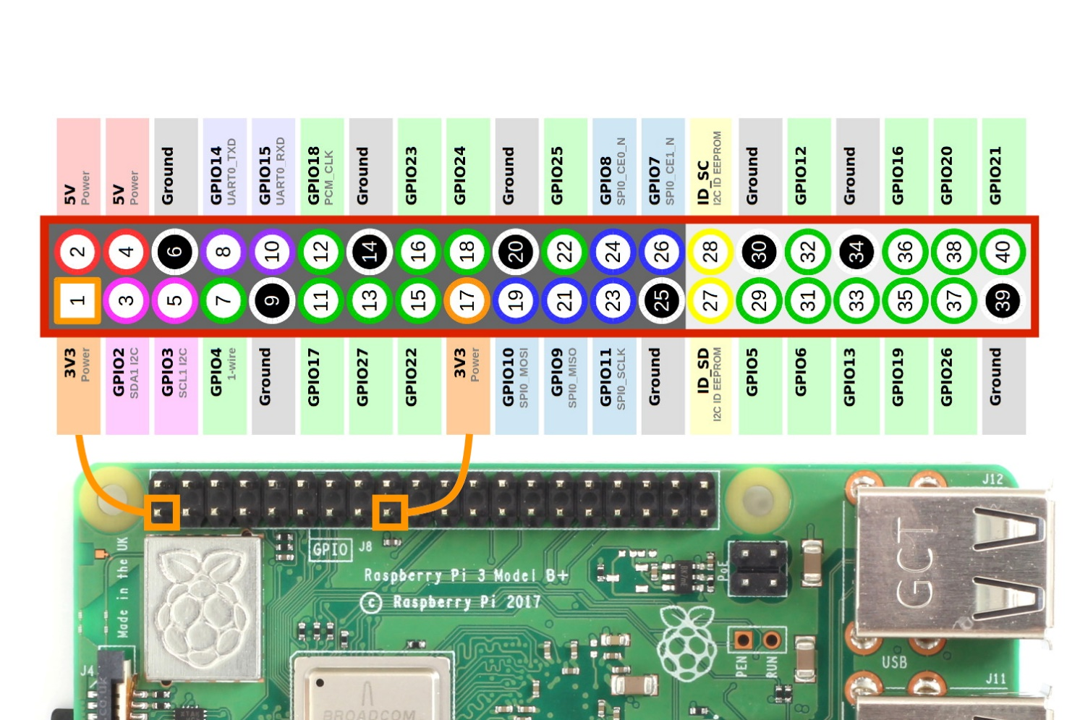
Raspberry Pi Pinout
The Raspberry’s 40 pin header make it unique.
You can add sensors, motors, servo’s, LED’s and much more to it and control the inputs and out outputs with code.
Pin Numbers and GPIO numbers are different.

Slide 6
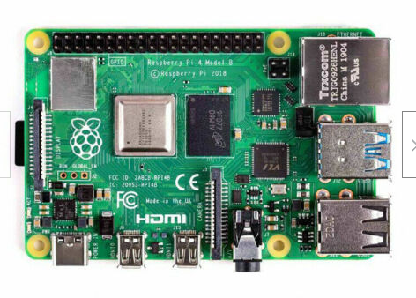
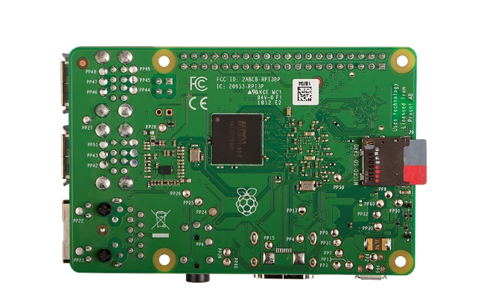
Raspberry Pi – Easy to short circuit the bottom pins
Wrist-straps not required but touch metal on the Rpi USB to dissipate ESD.
Never place bare board on metal surface.
Be careful not to touch the 40 pin header with any metal also.

Slide 7
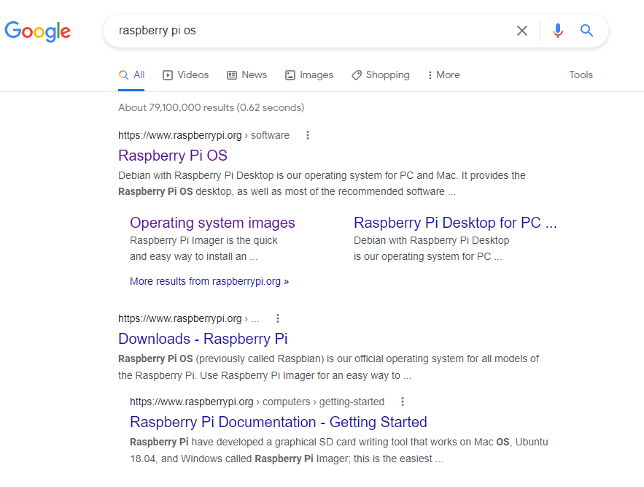
How to image the SD card
Search for Raspberry Pi OS

Slide 8
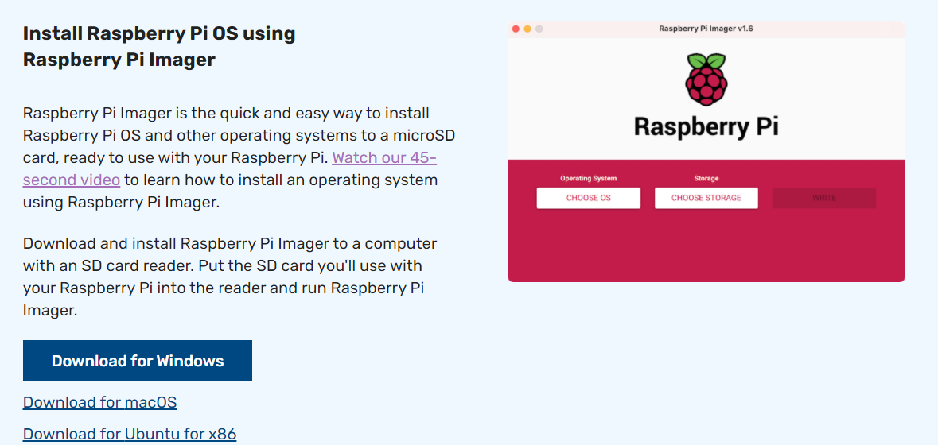
Download the installer for your system
This will install the latest SW
You have to download a huge file for previous versions.

Slide 9
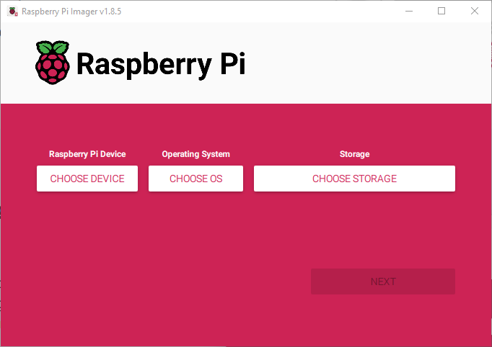
Open Raspberry Pi Imager
You will need to install the Raspberry Pi imager
Easiest way is to click on it from the downloads dialog in the browser you just downloaded it with
You may need to work through the Windows dialogs trying to save you from yourself
Notes:
OF NOTE: there are some great options below for automatic setup of specific use cases. If you need 64 bit, you’ll have to click “Raspberry Pi OS (other)” and choose from the plethora of options in there. There’s PROBABLY already an image ready for whatever you are doing as a baseline, so look through the options if you need something specific before you choose to just start from scratch, it may save you hours of time learning how to install specialized packages and then how to properly configure them to do what you want.

Slide 10
Open Raspberry Pi Imager
You will need to install the Raspberry Pi imager
Easiest way is to click on it from the downloads dialog in the browser you just downloaded it with
You may need to work through the Windows dialogs trying to save you from yourself
Notes:
OF NOTE: there are some great options below for automatic setup of specific use cases. If you need 64 bit, you’ll have to click “Raspberry Pi OS (other)” and choose from the plethora of options in there. There’s PROBABLY already an image ready for whatever you are doing as a baseline, so look through the options if you need something specific before you choose to just start from scratch, it may save you hours of time learning how to install specialized packages and then how to properly configure them to do what you want.

Slide 11

Click on CHOOSE DEVICE

Slide 12
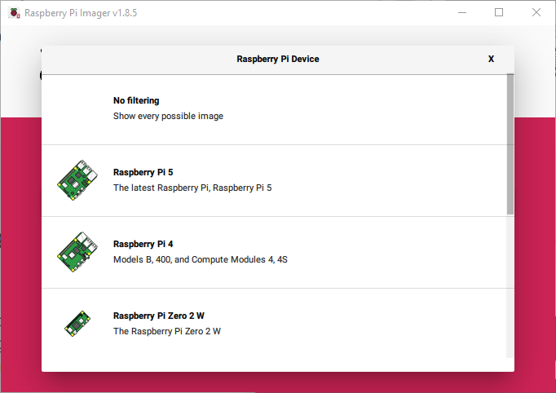
Choose the Raspberry Pi Device
Pick the device you are preparing an image for
If you are in the workshop, you are probably using a Raspberry Pi 4
Notes:
OF NOTE: there are some great options below for automatic setup of specific use cases. If you need 64 bit, you’ll have to click “Raspberry Pi OS (other)” and choose from the plethora of options in there. There’s PROBABLY already an image ready for whatever you are doing as a baseline, so look through the options if you need something specific before you choose to just start from scratch, it may save you hours of time learning how to install specialized packages and then how to properly configure them to do what you want.

Slide 13
Click on CHOOSE OS

Slide 14
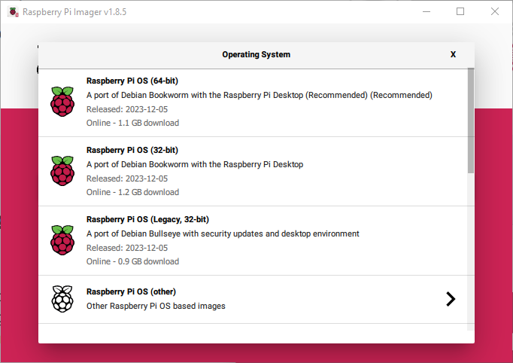
Choose the Raspberry Pi OS
There are a TON of options for different OS configurations
We will use Raspberry Pi OS (Legacy, 32-bit) as everything plays nicely.
Notes:
OF NOTE: there are some great options below for automatic setup of specific use cases. If you need 64 bit, you’ll have to click “Raspberry Pi OS (other)” and choose from the plethora of options in there. There’s PROBABLY already an image ready for whatever you are doing as a baseline, so look through the options if you need something specific before you choose to just start from scratch, it may save you hours of time learning how to install specialized packages and then how to properly configure them to do what you want.
For your Pi outside of the workshop, any option is fine – HOWEVER be advised the networking and remote desktop situation is drastically different with the “Debian Bookworm” based versions.

Slide 15
Plug the SD card into your computer and select Choose STORAGE

Slide 16
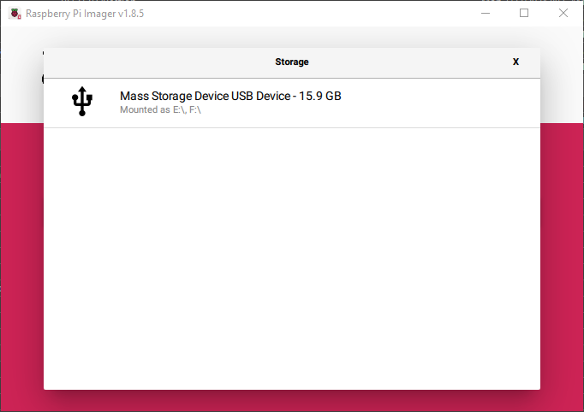
SD card is P:\ on this system. Verify in Explorer. THIS WILL ERASE EVERYTHING ON THE CARD (when you click WRITE in a few steps)
Notes:
Best practice is to remove all other removable storage so the only on installed is the RPi SD card when performing this step. Disregard if you are experienced/fully competent and cognizant of how the removable storage system works in windows, but if you are unsure – stop, safely remove all of the other USB storage devices, and come back to this step!!!

Slide 17
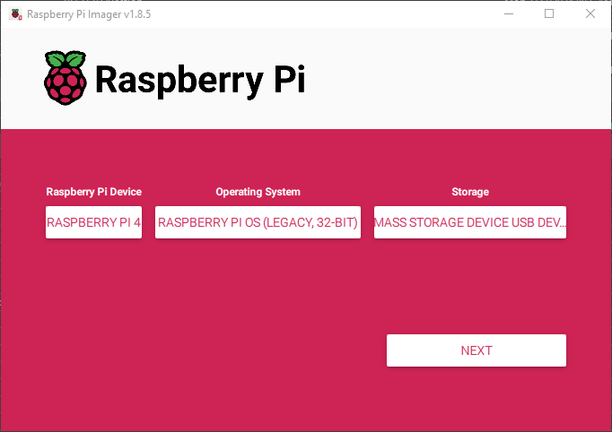
Click NEXT

Slide 18
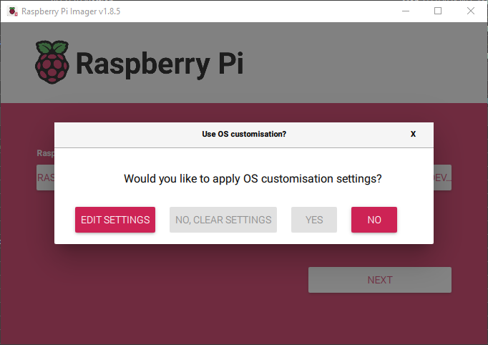
Click EDIT SETTINGS

Slide 19
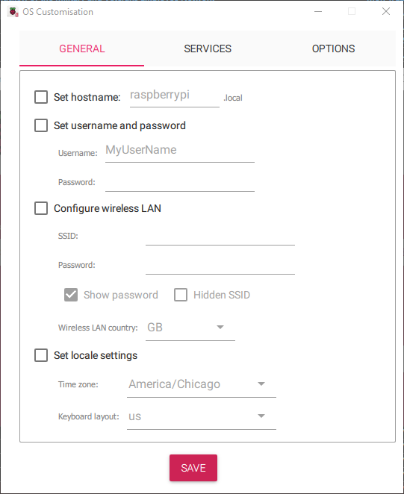
This will pop out a new window where you can customize all of the settings for your new operating system image
Notes:
The window was enlarged to show the entire critical contents of the advanced settings – your window will not change sizes when you click on the gear.

Slide 20
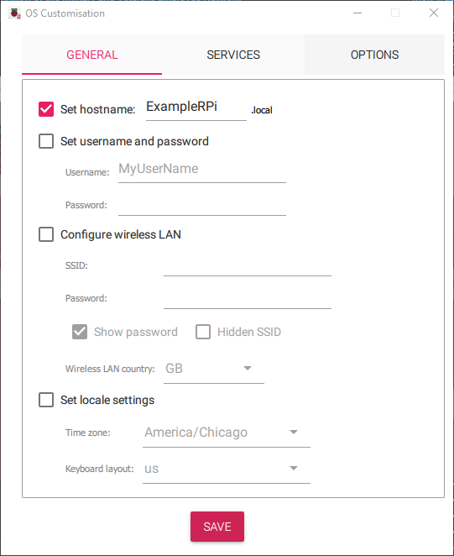
Set the hostname
Click the box next to Set hostname
Put in a unique hostname – this is important if you have more than one Raspberry Pi on the same network
Make a note of the hostname you set
Notes:
Networks hate having more than one instance of a hostname. If you are running more than one RPi on your network, make absolutely sure they each have unique hostnames! Also, this name is critical in a few steps where we gain remote access without ever hooking up a monitor, keyboard, or mouse to the Raspberry Pi. It’s 1000% worth it to take the time to set a hostname now, and if you might forget what you set it to – make a note somewhere you can refer to in a few minutes!

Slide 21

Set username/password
Click the box next to Set username and password
Set a non-default username and password
make a note of these for later, you won’t be able to access your pi without them!
Notes:
What happens if you don’t change the username and password? You get hacked! The Raspberry Pi has been around for quite a while, and the default username and password have been the same for nearly the entire run. If your Pi reaches out to the internet and a bad actor takes note, they own your Raspberry Pi! Change your username and password and keep your tiny computer secure!!! SSH allows anyone with the username and password access to the machine with the access level granted by the credentials. By default, SSH is not enabled – but the manufacturer’s assumption is that you will be using physical peripherals (keyboard, video monitor, mouse) to interact with your Pi. As we are working towards a headless install that you remote into from another computer to control your Pi, the first step is changing the username and password, followed by enabling SSH – which opens your Pi up to the dangers of being on the internet and easily accessible to anyone with the credentials. The default username and password have “root” access (administrator level access) – so if someone can log in to your Pi with those credentials, they can make your Pi a bot, install malware, ruin your day, derail your projects, and waste your precious time.

Slide 22
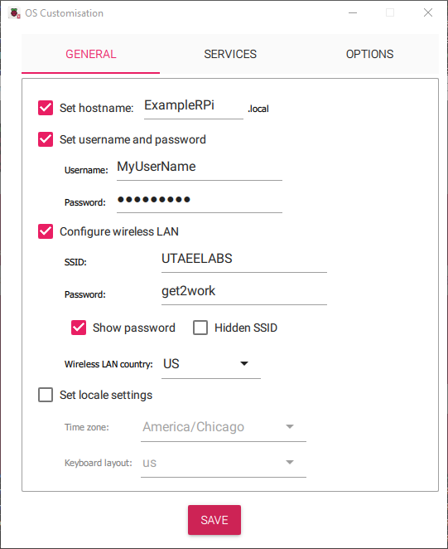
Setup Wi-Fi
Click the box next to Configure wireless LAN
Click on the line next to GB for Wireless LAN country, delete and replace with US
Enter the SSID and Password shown
Click on the arrow next to the country code to verify it took US (should be a popup with US in pink at the top)
Notes:
Different countries operate Wi-Fi with different parameters and spectrum allocation. Wi-Fi channels in GB don’t perfectly align with the Wi-Fi channels of the US, for example, so you are limited to those channels that overlap, and you may suffer reduced bandwidth and dropouts if you don’t set this correctly.
If you are following this tutorial for your personal Rpi put in your two-letter country code if this isn’t for the workshop – it needs to match the rest of the hardware on your network wherever you are physically located on the globe.
This is the username and password for the bandwidth limited very restricted network in the Lab – it gets a tunnel out of the UTA network to the internet, but it doesn’t offer much – including VERY slow access to the internet.

Slide 23
Enter Wi-Fi details
At this point, the Raspberry Pi CANNOT log in to the normal UTA wifi – the credentialling system is too complex for the default network manager of the LEGACY OS image
Use a simpler wifi network at this stage that only requires SSID and password
Notes:
Type in the actuals here – in the lab we use UTAEELABS for the SSID and get2work is the password. At home, you will want to input the correct SSID and password for your router. Later in this tutorial we will cover how to get the network manager updated so you can logon to the regular UTA Wi-Fi like a normal computer… but I haven’t written that part yet. Stay tuned!
Be advised – the CURRENT Raspberry Pi OS options use a different network manager, and it IS capable of logging into the UTA WIFI system using your username/password credentials that you would use on your laptop. HOWEVER, thanks to the secure nature of that network, any Raspberry Pi (or any device, really) that is connected to the UTA WIFI network is incapable of being remotely accessed. It has to do with the security posture, and blocking certain network ports and traffic. So, if you connect your Rpi to a wired connection, you can remotely access it over the network (as long as you are also using a wired connection). Long story extra long, at home you won’t have to worry about this, and in industry you can work with your network team to enable certain networking requirements to make this work, however with the UTA bureaucracy in place, the effort required to make this work from personal laptops to workshop raspberry pi’s is excessive. Which is why we have the UTAEELABS wifi network setup and available – it works, and is a better representation of what you would be working with at home.

Slide 24
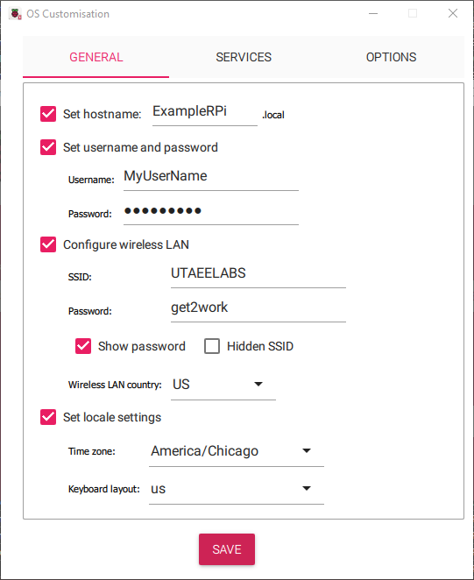
Set locale settings
Click the box next to Set locale settings
Set your timezone and Keyboard layout as shown
If you don’t have the correct keyboard layout for the physical keyboard you are using, many hotkey combinations and special characters are impossible or very difficult to use
Notes:
In linux, there are a number of really useful commands that are key-combinations. If the local is set incorrectly, when you try to stop a program from running <Ctrl-C>, it may not work. Likewise, when using the command line interface, the <~> is a shortcut to your home directory, however if I remember correctly, that is one of the keys that is remapped and difficult to get to appear. Perhaps one of the biggest issues this creates is remapping the <|> (pipe) character – which is used heavily in CLI commands. Just make sure the keyboard layout and time zone are set correctly for the kind of keyboard you are using and what your timezone is, it will save you a LOT of headaches.

Slide 25
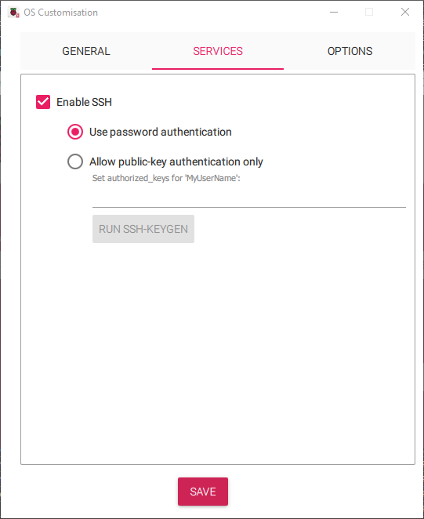
Go to Services Tab and Enable SSH
Click on the SERVICES tab
Click the box next to Enable
Use password authentication is fine
Notes:
What happens if you don’t change the username and password? You get hacked! The Raspberry Pi has been around for quite a while, and the default username and password have been the same for nearly the entire run. If your Pi reaches out to the internet and a bad actor takes note, they own your Raspberry Pi! Change your username and password and keep your tiny computer secure!!! SSH allows anyone with the username and password access to the machine with the access level granted by the credentials. By default, SSH is not enabled – but the assumption is that you will be using physical peripherals (keyboard, video monitor, mouse) to interact with your Pi. As we are working towards a headless install that you remote into from another computer to interact with your Pi, the first step is enabling SSH – which opens your Pi up to the dangers of being on the internet and easily accessible to anyone with the credentials. The default username and password have root access – so if someone can log in to your Pi with those credentials, they can make your Pi a bot, install malware, ruin your day, derail your projects, and waste your precious time.

Slide 26
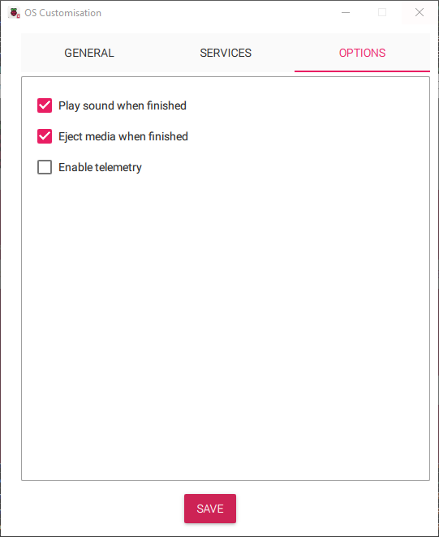
Options tab and SAVE
These are simply how you want the Raspberry Pi Imager to notify you and finish up when it completes writing the image to the SD card
I like the default options, but you should probably make sure Eject media when finished is selected
Click SAVE and you are ready to write the image with your configuration options

Slide 27
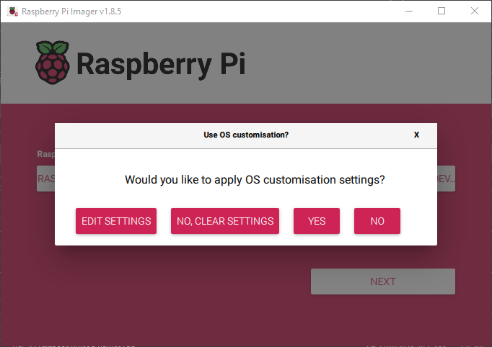
Click YES

Slide 28
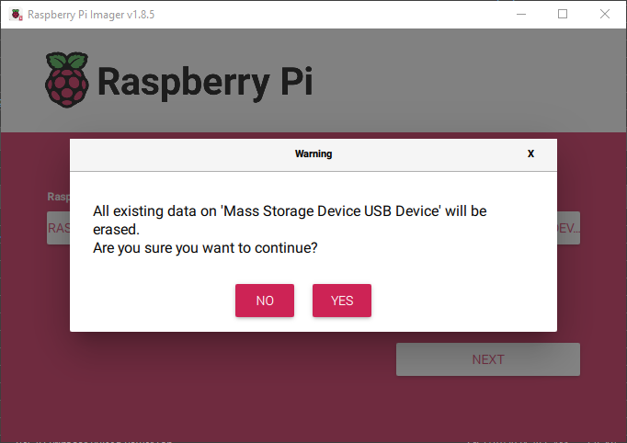
Click YES
BE ABSOLUTELY SURE YOU PICKED THE CORRECT STORAGE OPTION!!!!!
This is when it wipes the media, don’t be wrong when you click YES

Slide 29
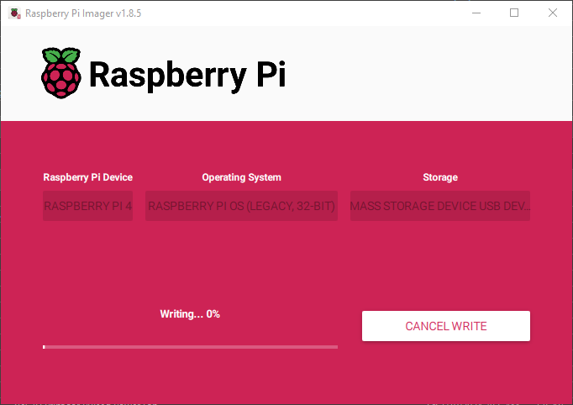
Wait for it to finish Writing to the SD card
Clicking Cancel will not save your data at this point if you chose the wrong Storage option
Notes:
Cancel will stop the writing process, but the repartitioning/reformatting of the sd card are nearly instantaneous and are the first things that happen. IF you screwed this up, there is a chance some 3rd party tool may be able to recover your files, but you just signed up for a huge headache and potentially hours or days of work to recover your files. The safest bet when doing this is to have only ONE removable drive installed when you are reimaging an sd card for a Raspberry Pi. The Raspberry Pi Imager automatically doesn’t allow you to choose internal storage, so you’ll only have one option. This takes a few minutes – it’s writing the entire boot drive and OS “hdd” that the RPi will run on, so it’s just going to take a bit. Be patient – it’s worth it!

Slide 30
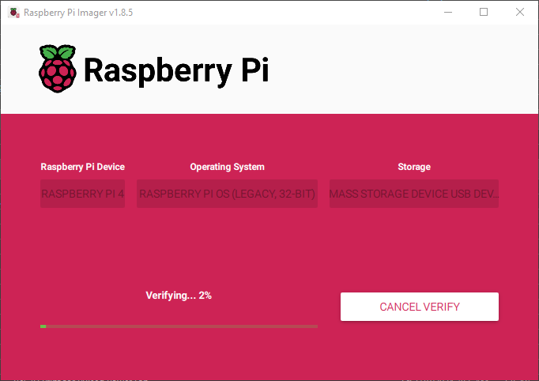
Wait for it to finish Verifying
It’s comparing the contents of the SD card to the original image file to make sure it wrote correctly
Notes:
I believe at this point it is doing a hash of the SD card and comparing it to the hash of the image file to make sure they match perfectly. It takes a couple minutes, so please continue being patient! If you don’t have the time for it to finish verifying, all it is doing at this point is verifying everything wrote correctly – you can cancel verify and it will not break the newly imaged SD card. It just won’t tell you it succeeded and that you can trust the new image on the SD card.

Slide 31
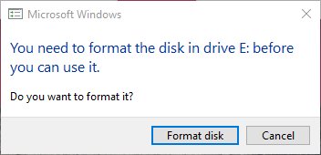
If necessary - Click Cancel on Windows popup
When Raspberry Pi imager finishes, windows looks at the SD card
One of the 2 partitions on the SD card is a format Windows can’t read, so it will think it’s corrupted and tell you need to format the disk
DO NOT CLICK “Format disk”
Notes:
If you format the disk, you win another round of using the Raspberry Pi Imager!

Slide 32
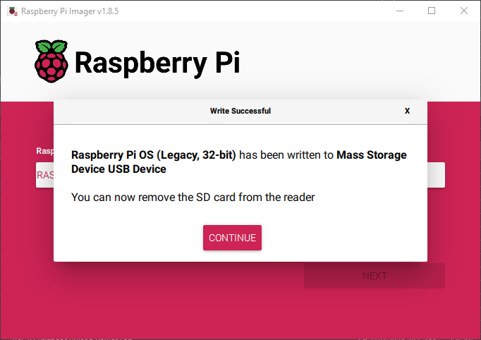
Remove the SD card from the computer
Success!
Click CONTINUE and yank that sd card -
It’s time to start working with the Raspberry Pi itself!
If you need to make more sd cards for additional Pis, and you want to use the same settings, make sure to change the hostname for each Pi that will be on the same network
Notes:
If you want to make a backup of the SD card with the expectation you might screw up the first copy, you can put in a different SD card, select storage and click write again and you’ll end up with 2 identical SD cards. Don’t run them both in different RPis at the same time on the same network or you will get hostname conflicts. But you CAN have them installed in different RPis if you are only going to run one on your network at a time (example remote data collection, you can shut down the rpi and swap in a different SD card, take the original back to the lab for data analysis). This is also useful if you are deploying a standardized configuration and want many identical copies of the same device but they will be installed on different networks. You will be able to access them anywhere with the same credentials and human readable network address.
If you want to make a DIFFERENT image (say you have a normal OS for developing a project, but you would also like to set up an image for a media player or retro games system, and you want to swap the SD card in a single Pi to use it for multiple uses at different times), you can start from step one but keep all of the advanced settings – so you will be able to access the Raspberry Pi exactly the same via the network.
The OS choice and advanced settings are really powerful parts of the imager, but for the workshop we just need the basic, default 32bit OS.

Slide 33
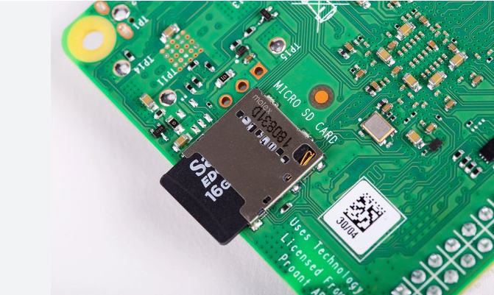
Insert the Imaged SD card into the Raspberry pi
Be gentle.

Slide 34
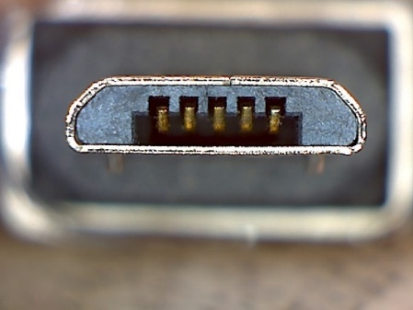
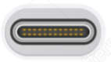
Connect Power
Again Gentle.
3B+ has directional USB Micro.
Rpi 4 has USB C and can plug in either way.
Once the pi completely boots up: wait before proceeding.
The first bootup might take a minute or two
USB - Micro
USB - C

Slide 35
Connect to your Pi remotely – CLI and initial setup
Run cmd in windows
Type ping hostname.local and hit return
where hostname is the hostname that you set in the Raspberry Pi Imager
You may need to try a couple times
If it’s been more than 5 minutes, something is probably wrong
When you get a response that looks like this, your RPi is online and accessible
Pinging hostname.local [fe80::2ed3::cea2:107b:7f26%18] with 32 bytes of data
Reply from fe80::2ed3::cea2:107b:7f27%18: time=15ms
Reply from fe80::2ed3::cea2:107b:7f27%18: time=15ms
Reply from fe80::2ed3::cea2:107b:7f27%18: time=15ms
Type ssh username@hostname.local and hit return
where username and hostname are what you set in the Raspberry Pi Imager
Notes:
Ping is a network tool used for checking whether another device is accessible via the network you are connected to. You can use either an IP address or at hostname.network. .local is a special network for devices using zeroconf (advanced topic, not necessarily important for this discussion), so you can access any device with hostname.local as long as they are within the same network (this is an oversimplification but works for this explanation.)
ssh is a tool (secure shell) that allows a user access to a shell (command line interface) remotely. It can use the same addressing schema as ping, so it can also user hostname.local to access another system.
Neither of these are specific to raspberry pi or special in this use – these are established and ubiquitous tools used in managing THE internet and are very powerful tools.
The username and password are case sensitive – if you capitalize it differently, the computer sees it as uniquely different. Be careful!

Slide 36
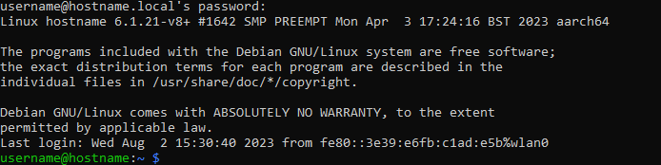
Connect to your Pi remotely – CLI and initial setup
The first time you ssh to a new device you get a message along the lines of
The authenticity of host ‘hostname.local (fe80::2ed3::cea2:107b:7f26%18)’ can’t be established.
ECDSA key fingerprint is SHA256:SLKJDfAS:LDkljxgklsadfjg23kjagn;lkan.
Are you sure you want to continue connecting (yes/no/[fingerprint])?
The actual fingerprint will be unique to this specific OS install on your Pi
If you reimage your SD card, it will generate a new unique fingerprint
Type yes (the whole word) and hit return
This will result in the following output
Warning: Permanently added ‘hostname.local, fe80::2ed3::cea2:107b:7f26%18’ (ECDSA) to the list of known hosts.
username@hostname.local’s password: _
Type in your password and hit return
This is the command line interface (CLI) on your Raspberry Pi!!! Welcome to Linux!!!
Notes:
The long string after hostname.local is the IPV6 address of the human readable address. You probably won’t need to worry about it.
The SHA256: string is a hash calculated using SHA256 – you probably don’t need to worry about this either.
You will only need to type yes to continue connecting once during the first connection to a newly installed RPi OS. During the first bootup with ssh enabled, the RPi OS generates a unique key. Once you’ve opted to connect to that device, the key is permanently added to your local client library of ssh devices and you should never have to do this again.
The color line at the bottom is the standard cli command prompt. The anatomy of the line is username@hostname:<current directory> $
(with ~ symbolizing your home directory which is located at /home/username and the $ symbolizing the end of the line and beginning of where you can input a command)

Slide 37

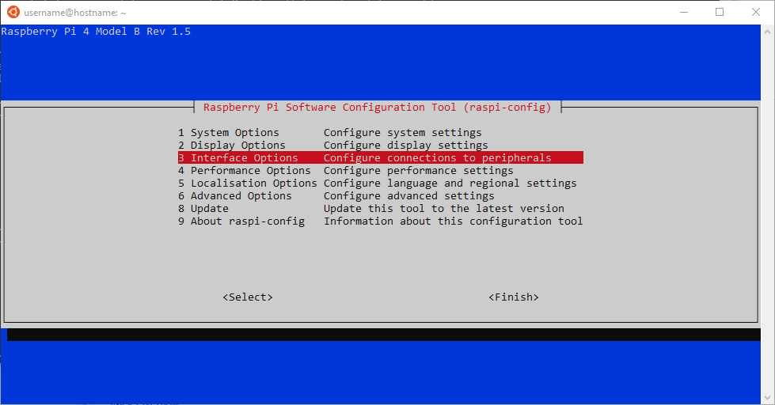
Connect to your Pi remotely – CLI and initial setup
Let’s enable VNC so you can use the GUI remotely as well now that we have remote CLI access
Type sudo raspi-config at the command line and press the Enter key
Use the arrow keys to select Interface Options and press the Enter key

Slide 38
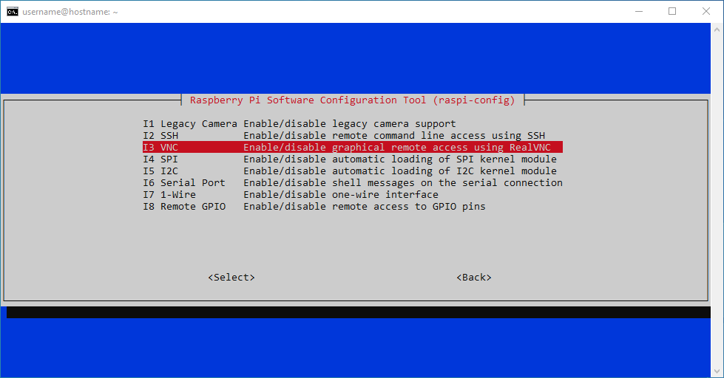
Connect to your Pi remotely – CLI and initial setup
Arrow down to select VNC
Press Enter

Slide 39
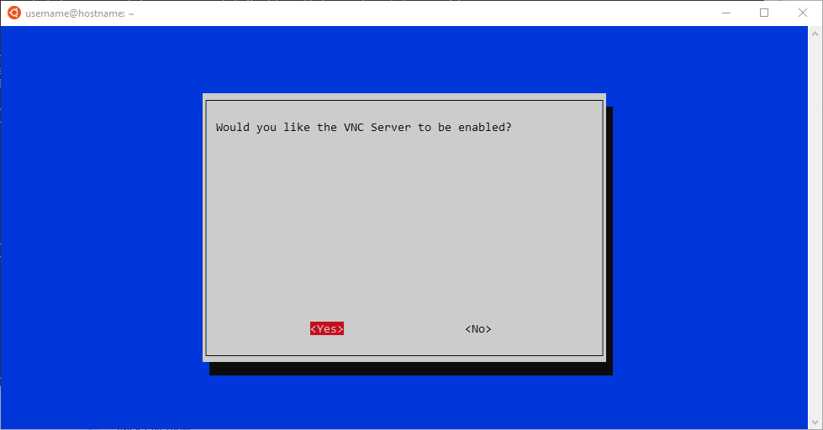
Connect to your Pi remotely – CLI and initial setup
Use the arrow keys to select <Yes> and hit enter

Slide 40
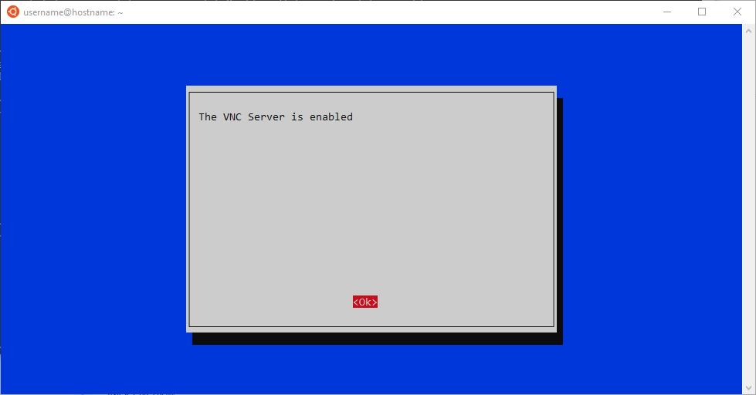
Connect to your Pi remotely – CLI and initial setup
After you hit Enter on yes, the system will update and inform you the VNC Server is enabled
Hit Enter to return to the main screen

Slide 41
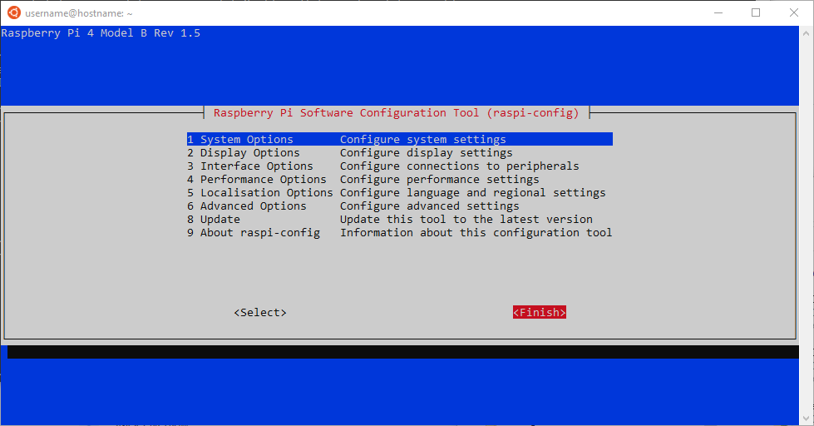
Connect to your Pi remotely – CLI and initial setup
Arrow right twice to highlight <Finish>
Hit Enter – this will return you to the CLI

Slide 42
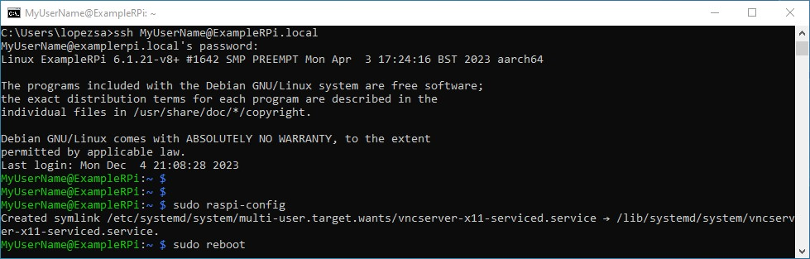
Reboot the right way!
To reboot type sudo reboot at the command line

Slide 43
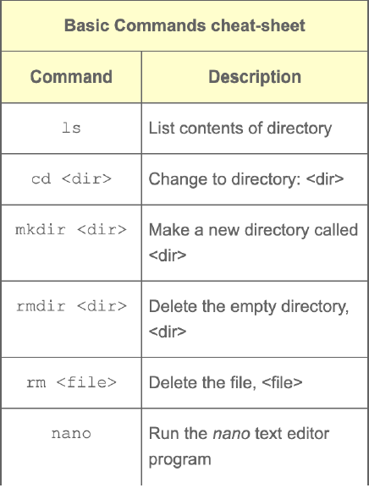
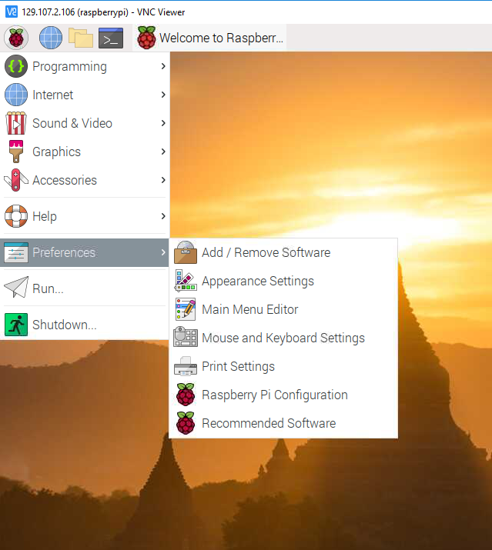
Terminal Commands
These are critical if you have ssh’d in and are sitting at a command line
If you are in the graphical user interface (GUI), you can open the Terminal window >_
This is Linux command prompt
Let’s see what these commands do

Slide 44

Don’t want a display, keyboard or mouse duct taped to your project?
Real VNC
Download https://www.realvnc.com/en/connect/download/viewer/ and install on your computer (not the Pi)

Slide 45
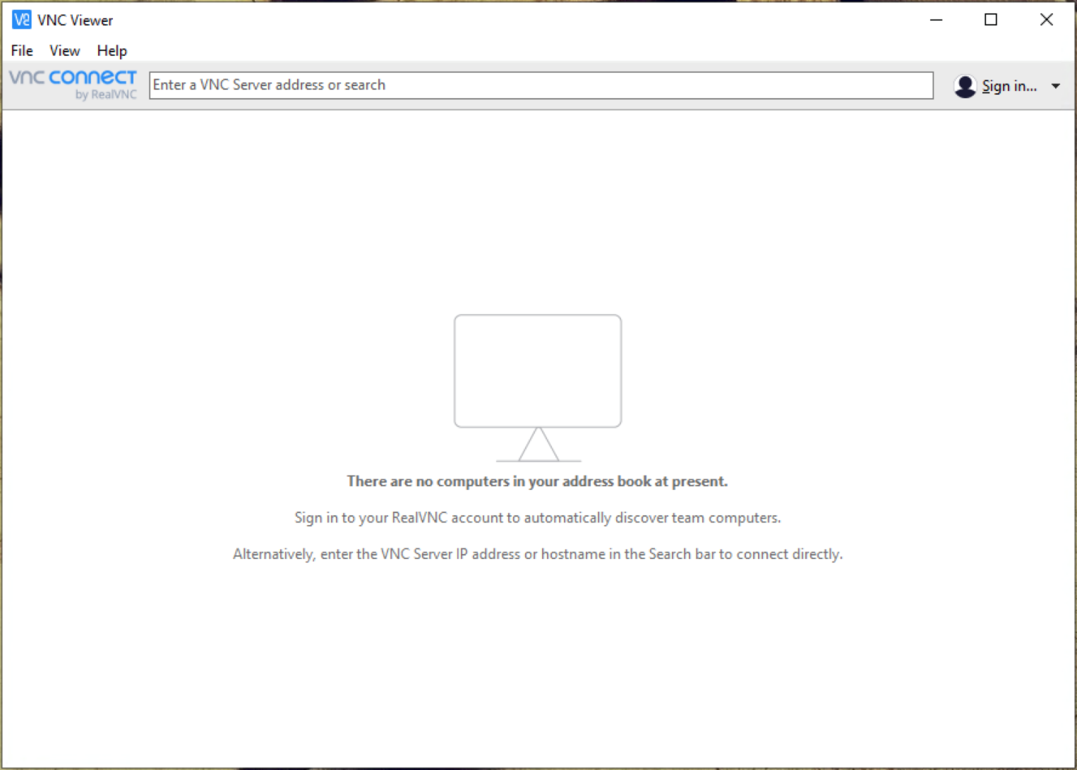
Headless Remote control !
Open Real VNC on your laptop and enter the address you used to ssh into your pi.
Ex: EELABXX.local
Enter your credentials
Ex: UTAEELABS :
PW: get2work
This should allow you to remotely control the raspberry Pi.
Notes:
Headless is a term used in computing that generally refers to a server or computer that is configured to run without needing to attach a keyboard, mouse, or monitor. Historically, computers that aren’t intentionally configured to enable this operating mode will fail POST (power on self test), and will never actually boot into an operating system. The raspberry pi used to require manual configuration to enable headless mode, however it’s been baked in to the standard OS image for many years now. In headless mode, when you apply power to the raspberry pi, it will automatically boot up into a fully operational state, and as long as you enabled ssh during the earlier configuration phase, you will be able to remotely access the Raspberry Pi and operate it exactly as if you had it plugged into dedicated input/output devices.
Following the method described in this tutorial, you should now be able to image and boot your raspberry pi with no extra keyboards, mice, or displays. As long as the computer you are trying to use to remotely control the Pi is on the same network, you are up and running at this point. This works so well, you don’t even need a computer – you can use your smartphone to access and control your raspberry pi if you need to! Now you can setup breadboards and test circuits using the GPIO anywhere as long as you have a Wi-Fi connection and power.

Slide 46
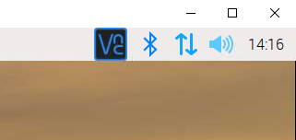
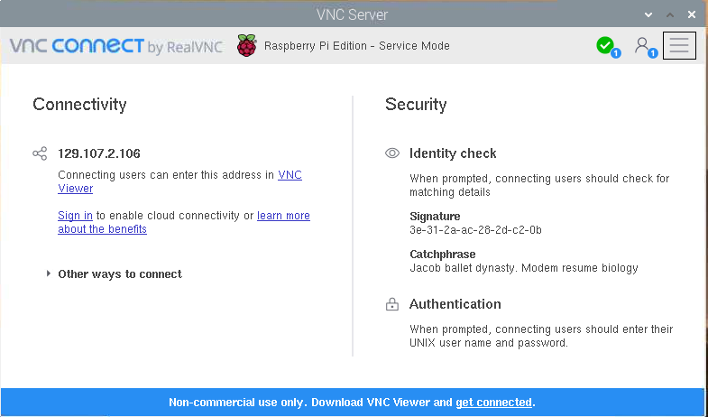
Remote control if you setup your pi using KVM !
Click the VNC button in the upper right
This will give you the Pi’s IP Address
Open Real VNC on your laptop and enter the address
Use the credentials you used when you imaged the SD card
This should allow you to remotely control the raspberry Pi!
Notes:
KVM is shorthand for Keyboard Video Mouse, and refers to if you have your Rpi setup like a traditional computer with its own display and input devices. This isn’t always necessary, but if you have the devices around it can be convenient, especially if you are having trouble getting the network connection to work or you are on a fairly locked down network that breaks things like ping/VNC/ssh/etc. If you skipped the advanced configuration part of the SD card imaging process and you are having trouble finding your Rpi on the network, or your network is blocking your remote access, your only option to further configure your Rpi for your needs may be to find a monitor and input devices and pretend you are setting up a desktop computer.

Slide 47
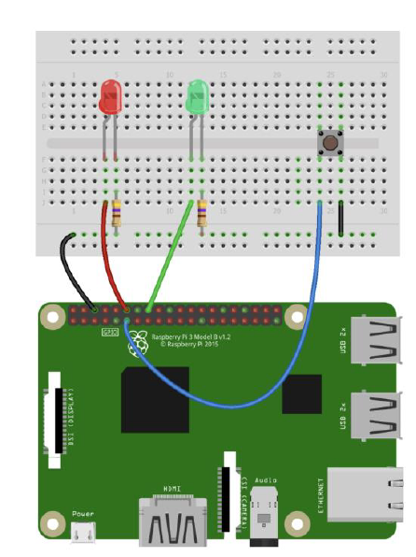
Blink LED’s in Python.

Slide 48
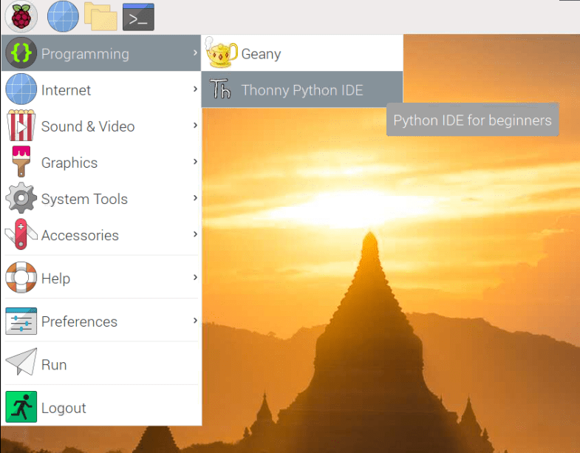
Open Thonny from the programming menu
Download the Button Blink code.py code from the GitHub page and paste it into Thonny.
Save the file as Button Blink code.py
The interesting fact is that the programming language Python was implemented by Guido van Rossum.
Whilst Guido van Rossum was implementing Python, he was also reading the published scripts from Monty Python’s Flying Circus.

Slide 49
Copy and Paste : Button Blink PWM code.py below into Thonny
import RPi.GPIO as GPIO
import sys
from time import sleep
butPin = 17
GPIO.setwarnings(False)
GPIO.setmode(GPIO.BCM) # GPIO.BOARD to reference pin numbers
GPIO.setup(18, GPIO.OUT)
GPIO.setup(23, GPIO.OUT)
GPIO.setup(butPin, GPIO.IN, pull_up_down=GPIO.PUD_UP)
try:
while 1:
if GPIO.input(butPin):
GPIO.output(18, GPIO.HIGH)
GPIO.output(23, GPIO.LOW)
sleep(.2)
GPIO.output(18, GPIO.LOW)
GPIO.output(23, GPIO.HIGH)
sleep(.2)
#Pressed
else:
GPIO.output(18, GPIO.LOW)
GPIO.output(23, GPIO.HIGH)
sleep(1)
GPIO.output(18, GPIO.HIGH)
GPIO.output(23, GPIO.LOW)
sleep(1)
except KeyboardInterrupt:
GPIO.cleanup()
Notes:
# https://sourceforge.net/p/raspberry-gpio-python/wiki/Examples/
GPIO.Board will refer to the pins

Slide 50
Button Blink PWM code.py
try: while 1: if GPIO.input(butPin): GPIO.output(18, GPIO.HIGH) GPIO.output(23, GPIO.LOW) sleep(.2) GPIO.output(18, GPIO.LOW) GPIO.output(23, GPIO.HIGH) sleep(.2) #Pressed else: GPIO.output(18, GPIO.LOW) GPIO.output(23, GPIO.HIGH) sleep(1) GPIO.output(18, GPIO.HIGH) GPIO.output(23, GPIO.LOW) sleep(1) except KeyboardInterrupt: GPIO.cleanup()
import RPi.GPIO as GPIO import sys from time import sleep butPin = 17 GPIO.setwarnings(False) GPIO.setmode(GPIO.BCM) # GPIO.BOARD to reference pin numbers GPIO.setup(18, GPIO.OUT) GPIO.setup(23, GPIO.OUT) GPIO.setup(butPin, GPIO.IN, pull_up_down=GPIO.PUD_UP)
Notes:
# https://sourceforge.net/p/raspberry-gpio-python/wiki/Examples/
GPIO.Board will refer to the pins

Slide 51
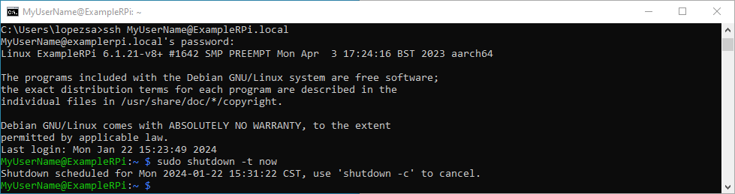
Shutdown the right way!
Option 1
You can shut down the Raspberry Pi directly from the CLI by typing
sudo shutdown –t now
Wait for the Raspberry Pi to finish shutting down correctly

Slide 52
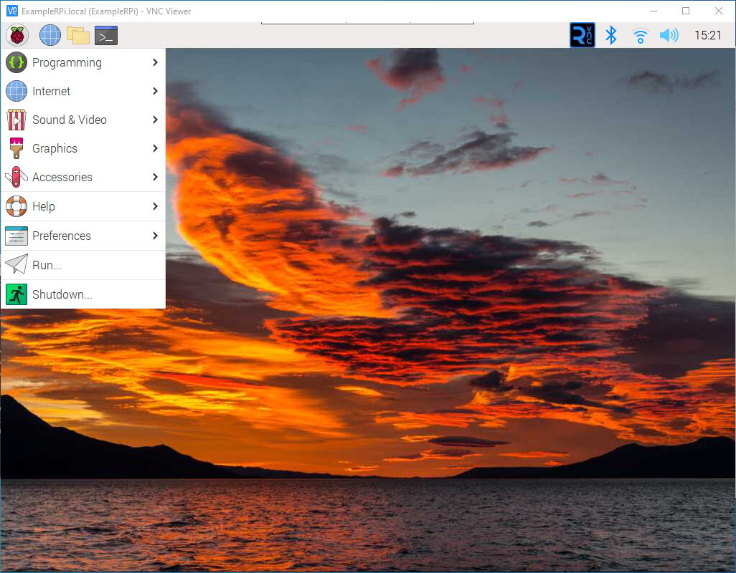
Shutdown the right way!
Option 2
Alternatively, if you are in the Rpi using VNC viewer: in the upper left corner click the Raspberry, then click Shutdown

Slide 53
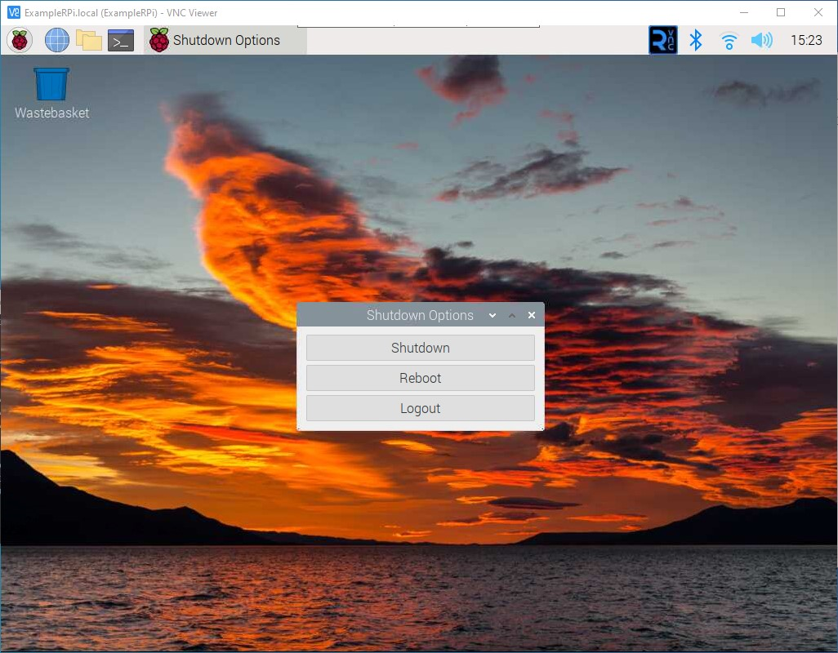
Shutdown the right way!
Option 2
Click Shutdown
Wait for the Raspberry Pi to finish shutting down correctly
Either way you decide to shut down the Rpi, you will need to wait for it to complete the shutdown procedure
Watch the 2 leds
When the green led goes out and stays out, it’s safe to remove power

Slide 54
Shutdown the right way!
Both Options
Either way you decide to shut down the Rpi, you will need to wait for it to complete the shutdown procedure
Watch the 2 leds
When the green led finally shuts off and stays off, it’s safe to remove power

Slide 55
Stay tuned
In the Second Raspberry Pi workshop we will build a Sound Board and do more Python programming…

